Slide 1
C22 Pollution
IGCSE Biology
Wendy Chai

Slide 2

Pollution - outline
Greenhouse gases
Acid rain
Chemical waste from industry
Eutrophication
Non-biodegradable plastics
Nuclear fall-out
Pesticides
Female contraceptive hormones
Waste disposal/ management
To help with your KWL chart, you can think of below clues where possible/ appropriate:
causes/ why, effects/ consequences, solutions/ actions we can take, processes/ how does it develop, advantages & disadvantages/ pros & cons, examples, terminology, importance, etc.

Slide 3
Objectives
To appreciate that humans have altered their environment considerably
To consider human impacts in terms of cause, effect and possible remedies:
Pollution of land and water, by pesticides (insecticides, herbicides), nuclear fall-out, non-biodegradable plastics
Pollution of air by CO2 & methane, explain causing enhanced greenhouse effect and climate change
Acid rain, possible remediation measures to reduce SO2 pollution
Explain eutrophication processes
Describe the negative impacts of female contraceptive hormones in water courses

Slide 4
Videos
Deforestation Effects on Climate.mp4
Deforestation, global warming, albedo, precipitation, runoff, partial harvesting, natural reserve areas, 3R,

Slide 5
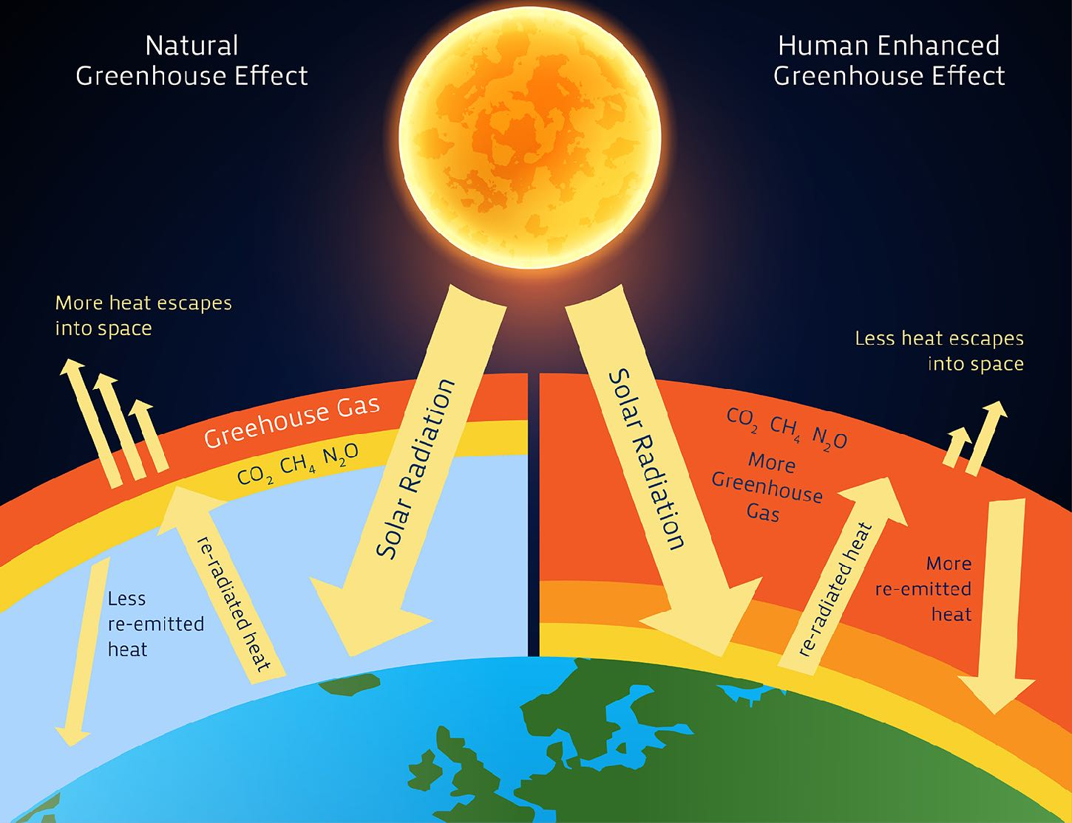
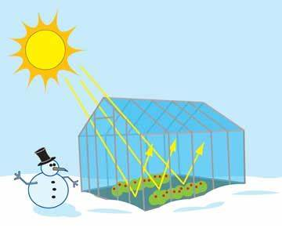
Greenhouse effect
Notes:
Earth is constantly bombarded with enormous amounts of radiation, primarily from the sun. This solar radiation strikes the Earth's atmosphere in the form of visible light, plus ultraviolet (UV), infrared (IR) and other types of radiation that are invisible to the human eye.
UV radiation has a shorter wavelength and a higher energy level than visible light, while IR radiation has a longer wavelength and a weaker energy level. About 30 percent of the radiation striking Earth's atmosphere is immediately reflected back out to space by clouds, ice, snow, sand and other reflective surfaces, according to NASA. The remaining 70 percent of incoming solar radiation is absorbed by the oceans, the land and the atmosphere. As they heat up, the oceans, land and atmosphere release heat in the form of IR thermal radiation, which passes out of the atmosphere and into space.

Slide 6

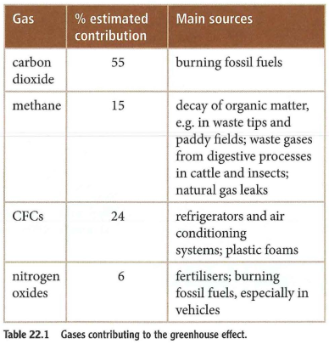
Greenhouse gases (GHG)
Carbon dioxide (CO2) and other greenhouse gases act like a blanket, absorbing IR (infrared) radiation and preventing it from escaping into outer space, making the atmosphere warmer. (greenhouse effect)
The effect is the gradual heating of Earth's atmosphere and surface is known as global warming.
What cause the dramatic increase of CO₂ in atmosphere?
Burning fossil fuels, Deforestation
Deforestation
Agriculture (paddy fields & cattle enteric fermentation); decaying in landfill sites; mining activities
Chlorofluorocarbon
Notes:
Glaciers and ice caps cover about 10 percent of the world’s landmass today. They hold about 75 percent of the world’s fresh water.
Rising sea levels could flood coastal communities, displacing millions of people in areas such as Bangladesh, the Netherlands, and the U.S. state of Florida. Forced migration would impact not only those areas, but the regions to which the “climate refugees” flee. Millions more people in countries like Bolivia, Peru, and India depend on glacial meltwater for drinking, irrigation, and hydroelectric power. Rapid loss of these glaciers would devastate those countries.
Many scientists use the term “climate change” instead of “global warming.” This is because greenhouse gas emissions affect more than just temperature. Another effect involves changes in precipitation like rain and snow. Patterns in precipitation may change or become more extreme. Over the course of the 20th century, precipitation increased in eastern parts of North and South America, northern Europe, and northern and central Asia. However, it has decreased in parts of Africa, the Mediterranean, and parts of southern Asia.
If forests are replaced with large-scale cattle ranching, it can double the warming effect on the atmosphere. Cattle ranching gives off a lot of pollution, both as surface water runoff and methane gas, a greenhouse gas that holds about 30 times more heat than carbon dioxide.

Slide 7
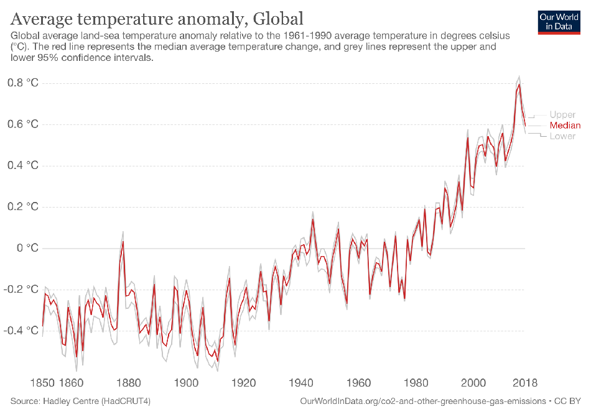
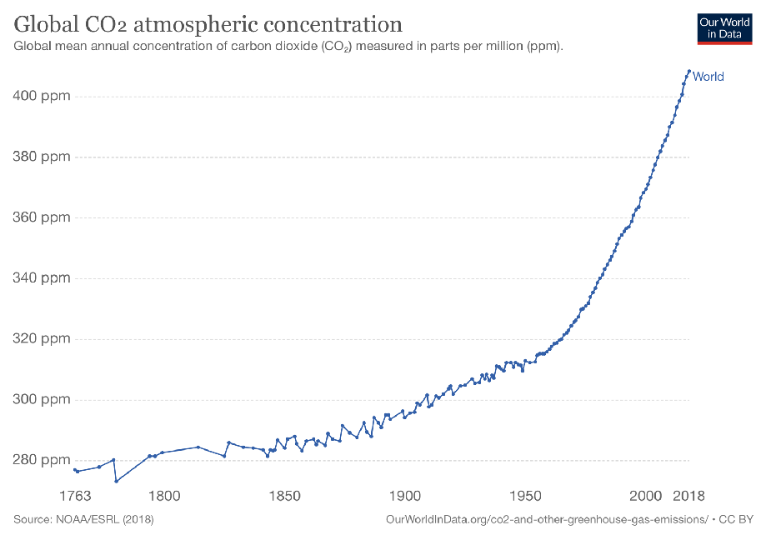
CO₂ emissions
https://ourworldindata.org/co2-and-other-greenhouse-gas-emissions

Slide 8
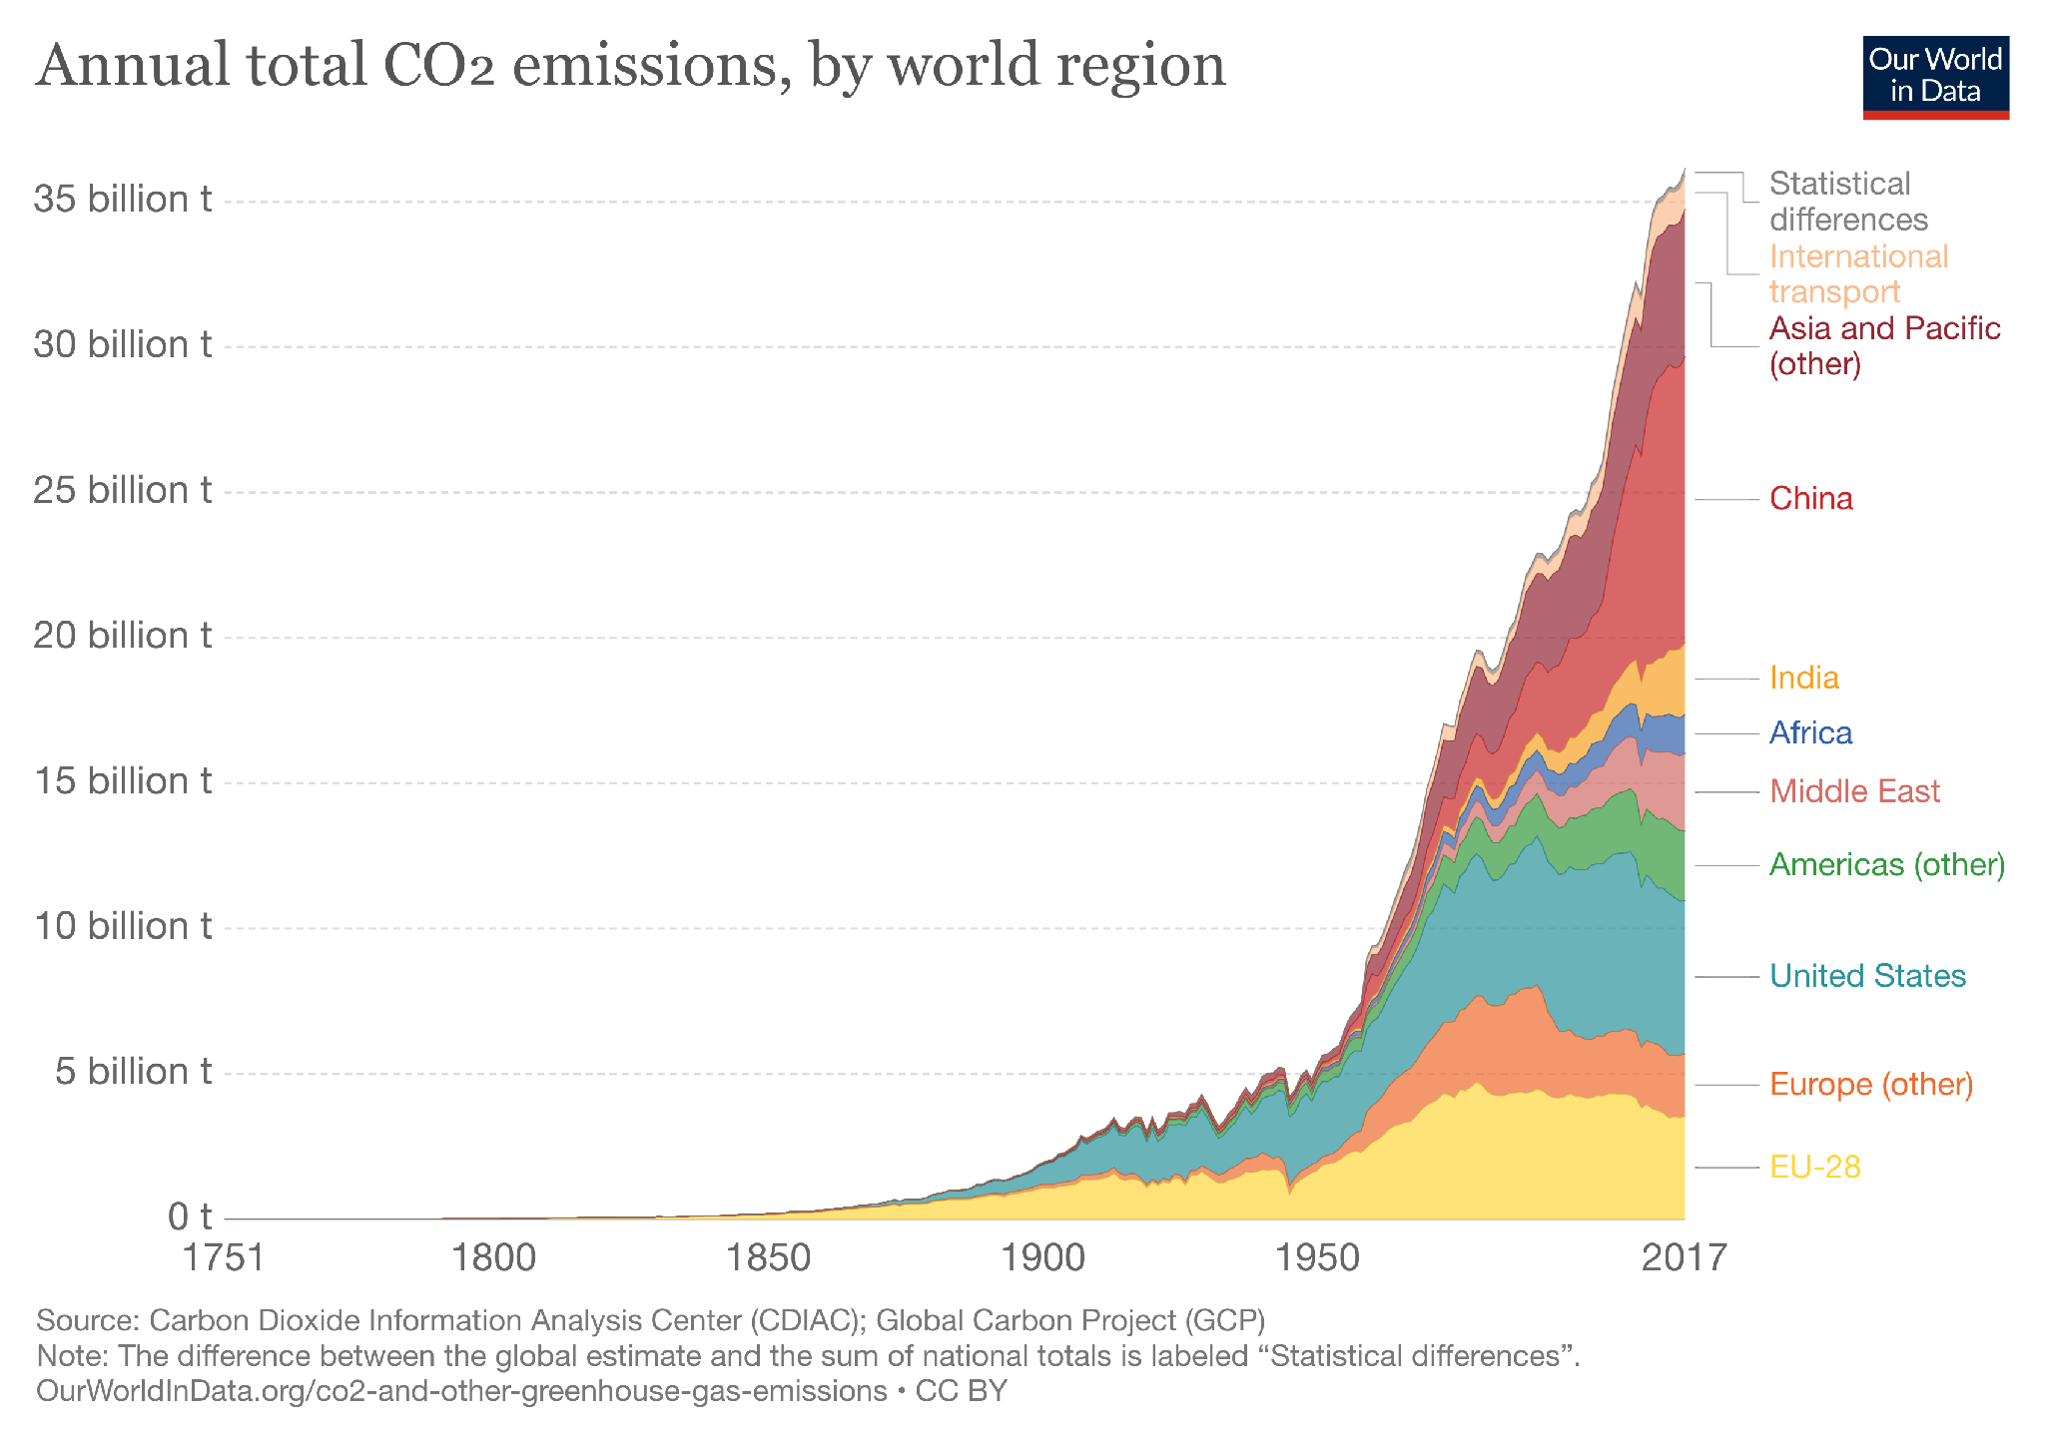

Slide 9
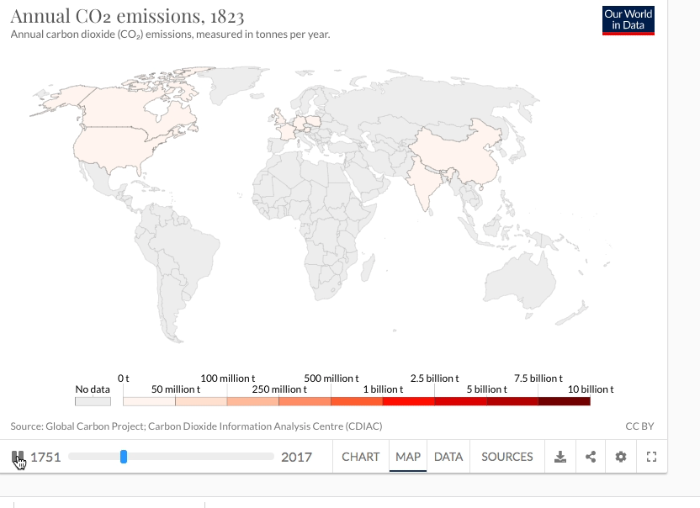
Annual CO2 emissions

Slide 10
Global warming effect
If global warming continues unchecked, it will cause significant climate change, glaciers and ice caps melting faster than usual, a rise in sea levels, coastal flooding, disrupted water systems, altered crop growth, extreme weather events (such as floods, droughts, storms, and heatwaves) and other severe natural and societal impacts

Slide 11
What can we do?
Protecting existing forests and planting new ones
Cut down fossil fuels burning:
improve energy efficiency in homes and businesses
improve the fuel efficiency of cars and other vehicles
We can also support development of alternative energy sources, such as solar power and biofuels, that don’t involve burning fossil fuels.
International agreements and action can save the planet's atmosphere.
The biggest effort so far has been the Kyoto Protocol (the international treaty for the United Nations Framework for Climate Change, specifically designed to reduce greenhouse gas emissions), which was adopted in 1997 and went into effect in 2005. By the end of 2009, 187 countries had signed and ratified the agreement. Under the protocol, 37 industrialized countries and the European Union have committed to reducing their greenhouse gas emissions.

Slide 12
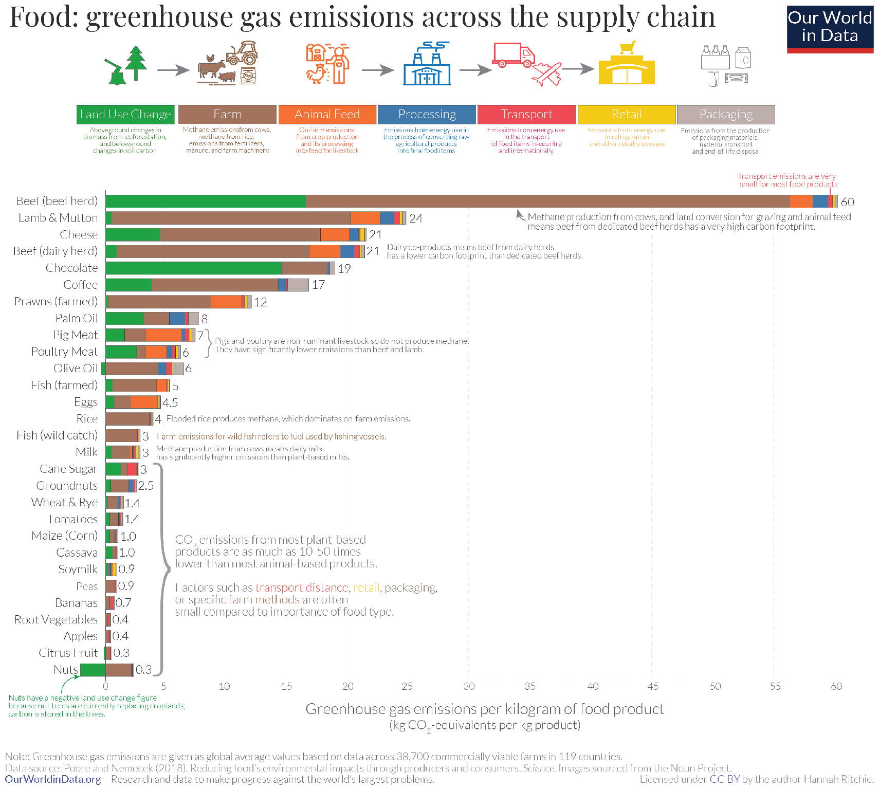

Food production impact - GHG emissions
https://ourworldindata.org/environmental-impacts-of-food
Notes:
This is data from the largest meta-analysis of global food systems to date, published in Science by Joseph Poore and Thomas Nemecek (2018).
For most foods – and particularly the largest emitters – most GHG emissions result from land use change (shown in green), and from processes at the farm stage (brown). Farm-stage emissions include processes such as the application of fertilizers – both organic (“manure management”) and synthetic; and enteric fermentation (the production of methane in the stomachs of cattle). Combined, land use and farm-stage emissions account for more than 80% of the footprint for most foods.

Slide 13
Global Warming Potential (GWP)
Greenhouse gases vary in their relative contributions to global warming; i.e. one tonne of methane does not have the same impact on warming as one tonne of carbon dioxide. We define these differences using a metric called ‘Global Warming Potential’ (GWP).
Chlorofluorocarbons (CFCs) and hydrochlorofluorocarbons (HCFCs) and other halogen gases typically have a high global warming potential (GWP): they are powerful greenhouse gases with a high capacity to trap heat in the Earth’s atmosphere. With a GWP up to 10,000 times higher than carbon dioxide (CO₂), these gases can have a notable impact on total greenhouse gas emissions, even in very small concentrations.
In the chart below we see the GWP100 value of key greenhouse gases relative to carbon dioxide. The GWP100 metric measures the relative warming impact one molecule or unit mass of a greenhouse gas relative to carbon dioxide over a 100-year timescale.

Slide 14
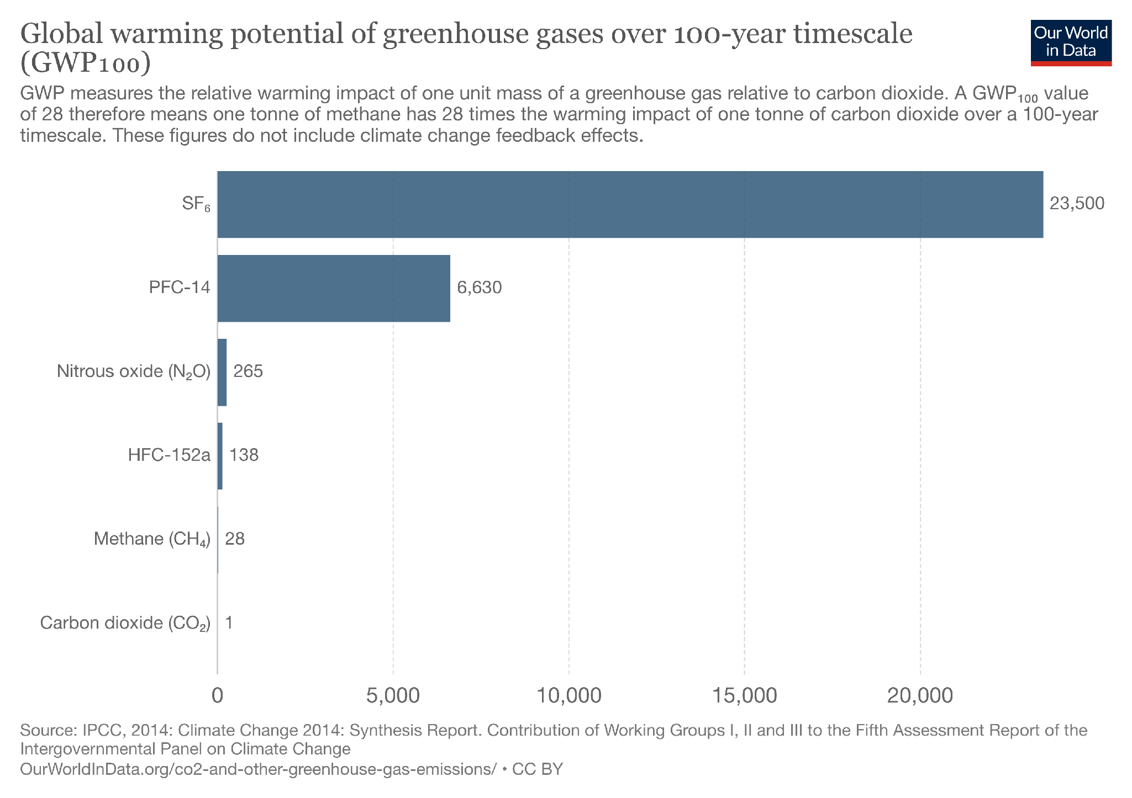

Slide 15
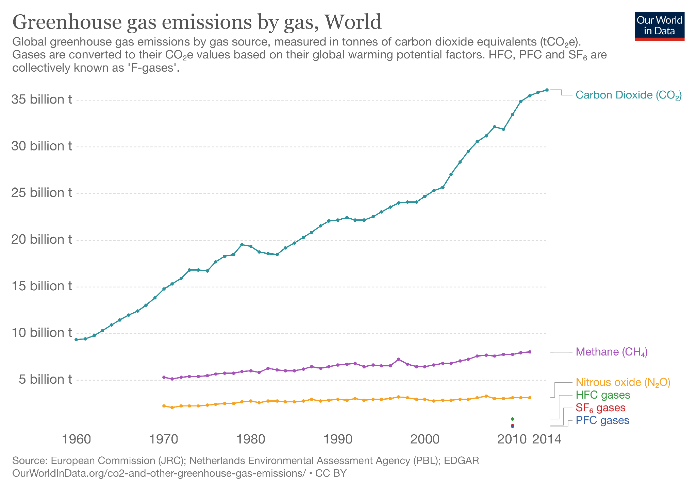

Slide 16
Ozone layer
Ozone (O3) is a gas which is present naturally within Earth’s atmosphere. It’s much less stable than oxygen (O2), and is therefore much more reactive; this means it can be more easily formed and broken down through interaction with other compounds.
Ozone in the stratosphere (typically extending from around 10 to 15km up to 50km depending on latitude) plays a crucial role in absorbing potentially dangerous ultraviolet (UV-B) radiation from the sun. The ozone layer typically absorbs 97-99 percent of incoming UV-B radiation.
Ozone-depleting substances (ODS) are halogen gases containing chlorine and/or bromine which have the potential to break down ozone in the stratosphere, including chlorofluorocarbons (CFCs), hydrochlorofluorocarbons (HCFCs), methyl chloride and bromide, and halons..
Ozone layer depletion increases the amount of ultraviolet (UV) irradiation that reaches Earth’s surface; this can increase the risk of skin cancer, particularly at higher latitudes.

Slide 17
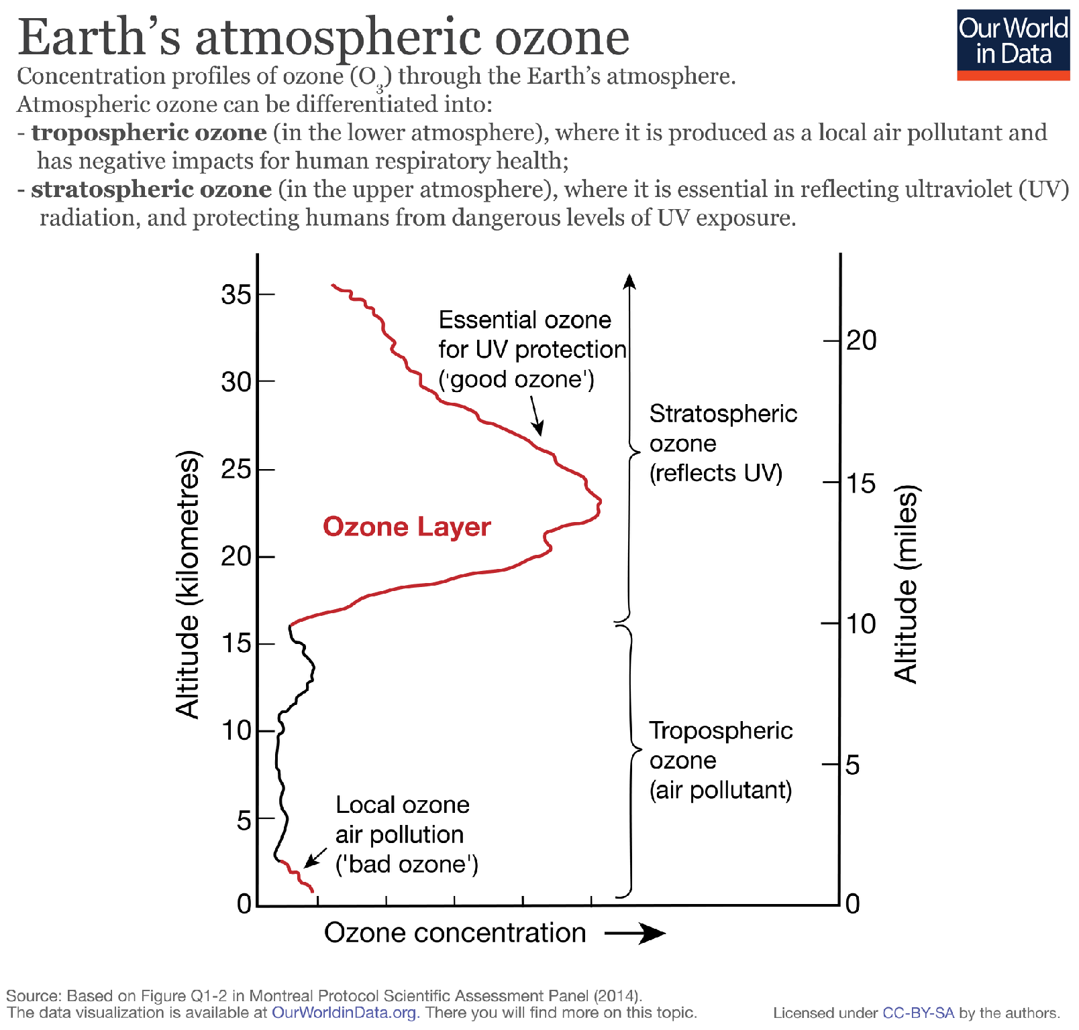

Slide 18
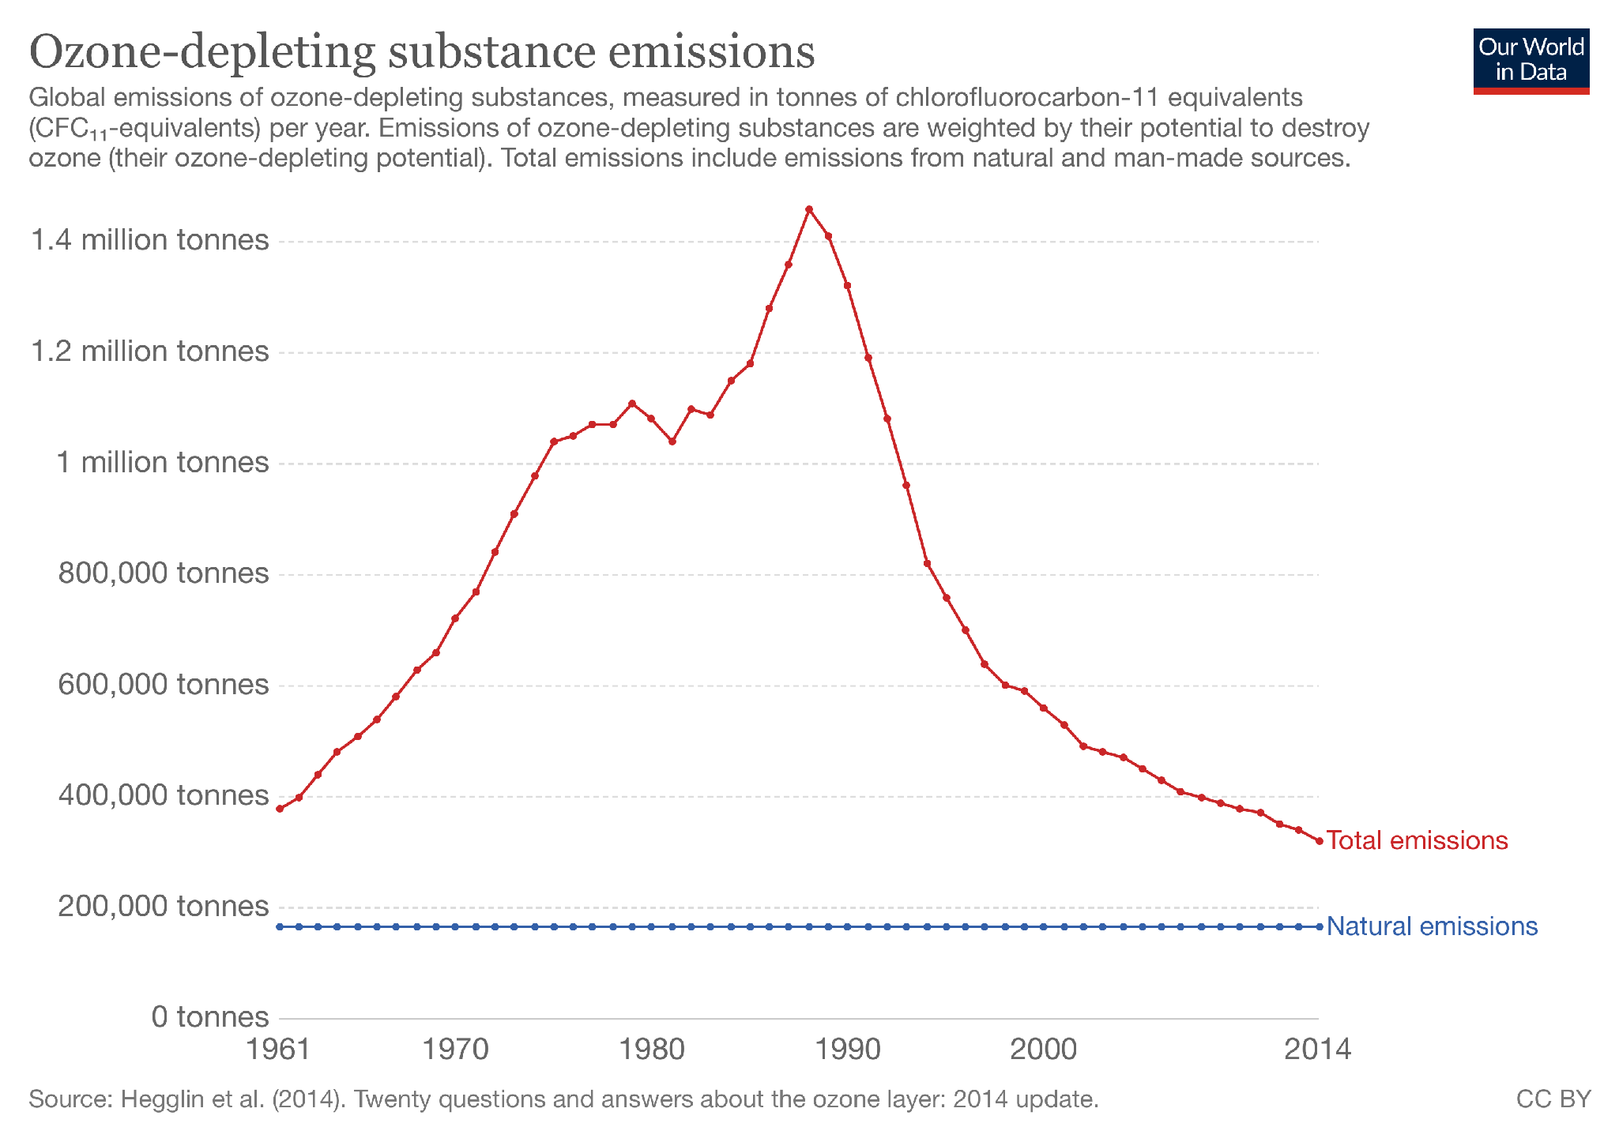
https://ourworldindata.org/ozone-layer
The Montreal Protocol is an international protocol to the Vienna Convention, agreed in 1987 before entering into force in 1989.
Its purpose was to phase-out (reduce and eventually eliminate) the use of man-made ozone-depleting substances for protection of the ozone layer.
Notes:
The Montreal Protocol is an international protocol to the Vienna Convention, agreed in 1987 before entering into force in 1989.
Its purpose was to phase-out (reduce and eventually eliminate) the use of man-made ozone-depleting substances for protection of the ozone layer.

Slide 19
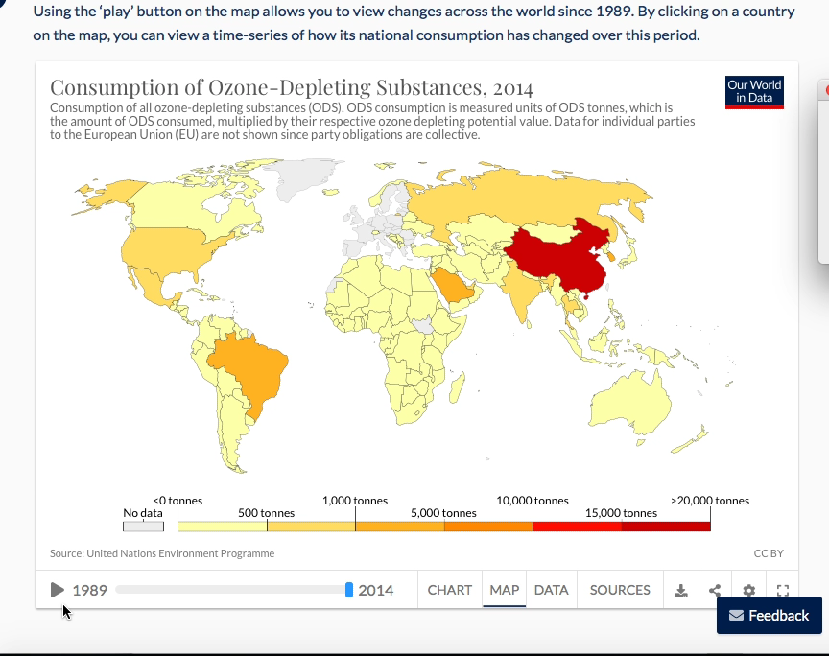

Slide 20
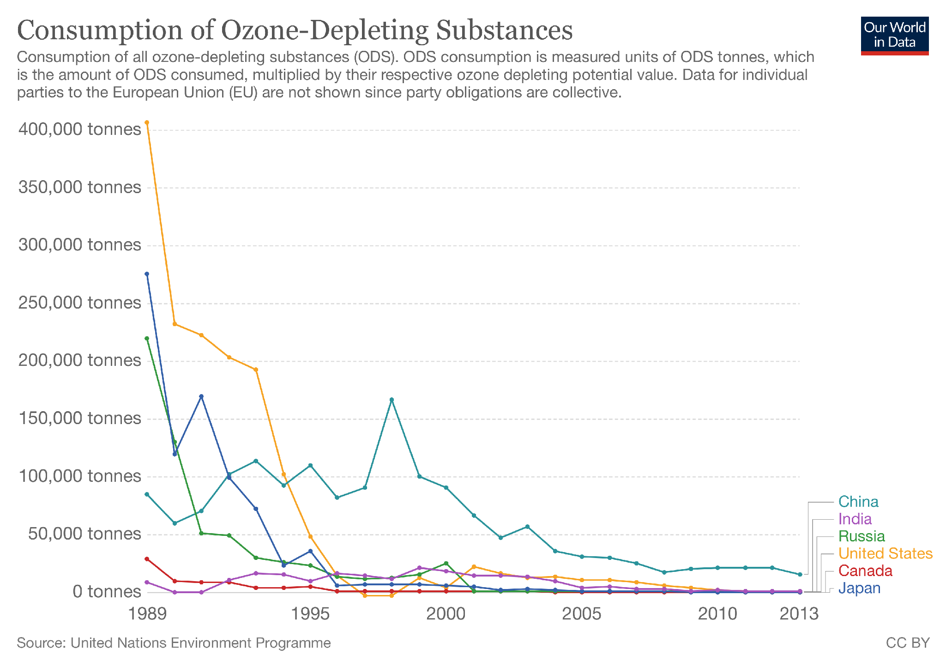

Slide 21
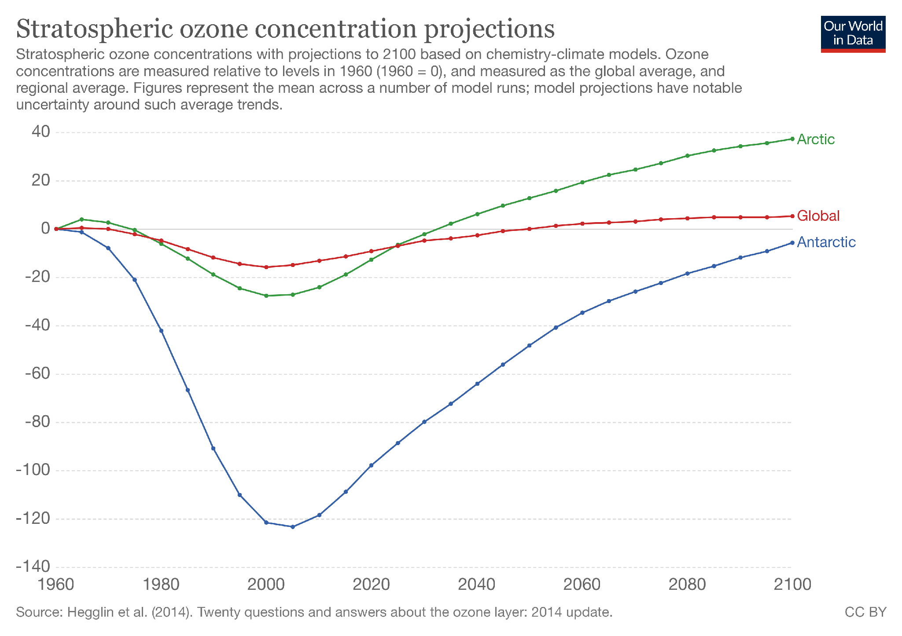

Slide 22
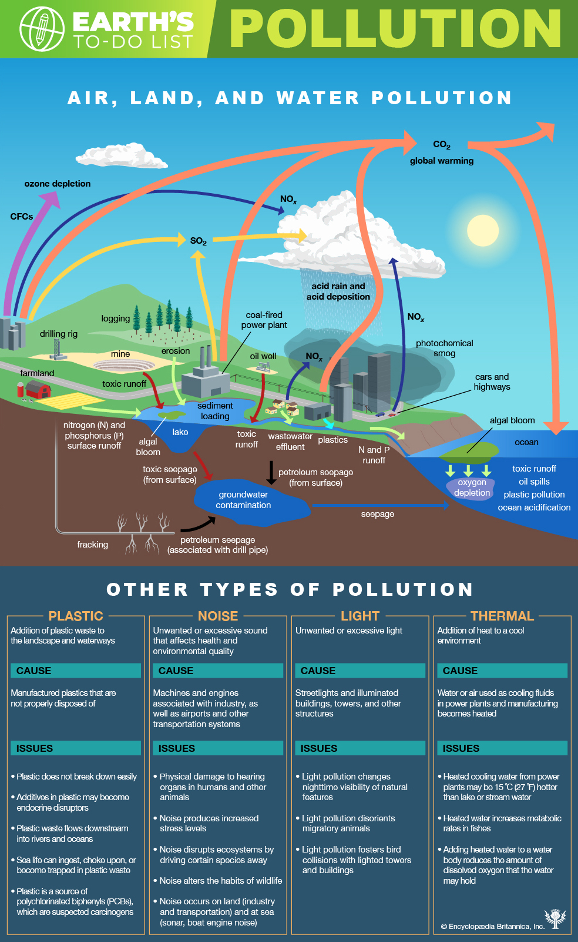
Earth’s Pollution

Slide 23
Earth’s pollution

Slide 24
Acid rain - causes
Acid rain, also called acid precipitation or acid deposition, is precipitation possessing a pH of about 5.2 or below primarily produced from the emission of sulfur dioxide (SO2) and nitrogen oxides (NOx; the combination of NO and NO2) from human activities, mostly the combustion of fossil fuels such as in power stations, factories and petrol-burning motor vehicles.
Nitrogen oxides can also be produced naturally by lightning strikes, and sulfur dioxide is produced by volcanic eruptions.
However, the geographic extent of any given natural source of acidification is small, and in most cases it lowers the pH of precipitation to no more than about 5.2.
Places significantly impacted by acid rain around the globe include most of eastern Europe, the eastern third of the United States, southeastern Canada and the southeastern coast of China.
https://www.britannica.com/explore/savingearth/acid-rain/
https://en.wikipedia.org/wiki/Acid_rain
Notes:
Acid rain has been shown to have adverse impacts on forests, freshwaters and soils, killing insect and aquatic life-forms, causing paint to peel, corrosion of steel structures such as bridges, and weathering of stone buildings and statues as well as having impacts on human health.
The problem of acid rain has not only increased with population and industrial growth, but has become more widespread. The use of tall smokestacks to reduce local pollution has contributed to the spread of acid rain by releasing gases into regional atmospheric circulation. Often deposition occurs a considerable distance downwind of the emissions.
In the United States, electric utilities produce nearly 70 percent of SO2 and about 20 percent of NOx emissions. Fossil fuels burned by vehicles account for nearly 60 percent of NOxemissions in the United States. In the atmosphere, sulfuric and nitric acids are generated when SO2and NOx, respectively, react with water.
Coal combustion is the leading source of atmospheric mercury, which also enters ecosystems by wet and dry deposition. (A number of other heavy metals, such as lead and cadmium, and various particulates are also products of unregulated fossil fuel combustion.)
The term acid rain is also somewhat misleading. Nitric and sulfuric acid can be transported to the Earth from rain but also via snow, sleet, hail, fog, mist, clouds, and dust clouds. Acid deposition also includes “dry deposition” made up of acidic particles and gases, which can affect landscapes during rain-free periods.

Slide 25

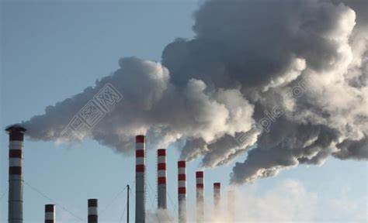
Acid rain

Slide 26
Acid rain - affect soil & vegetation
Fact: In the 1970s and ’80s, forested areas in central Europe, southern Scandinavia, and eastern North America showed alarming signs of forest dieback and tree mortality.
Soil biology and chemistry can be seriously damaged by acid rain.
Some microbes and insects are unable to tolerate changes to low pH and are killed.
Soil pH become lower. This can make it difficult for plants to absorb nutrients.
Acid rain also depletes soil of important plant nutrients, such as calcium and magnesium, and can release aluminum, which was bound to soil particles and rock, in its toxic dissolved form. As ions are leached (washed out) by acid rain thereby soil become short of these ions and plants can be deficient of nutrients.
Notes:
Soil chemistry can be dramatically changed when base cations, such as calcium and magnesium, are leached by acid rain thereby affecting sensitive species, such as sugar maple (Acer saccharum).
Adverse effects may be indirectly related to acid rain, like the acid's effects on soil (see above) or high concentration of gaseous precursors to acid rain. High altitude forests are especially vulnerable as they are often surrounded by clouds and fog which are more acidic than rain.
Other plants can also be damaged by acid rain, but the effect on food crops is minimized by the application of lime and fertilizers to replace lost nutrients. In cultivated areas, limestone may also be added to increase the ability of the soil to keep the pH stable, but this tactic is largely unusable in the case of wilderness lands. When calcium is leached from the needles of red spruce, these trees become less cold tolerant and exhibit winter injury and even death.

Slide 27
Acid rain - affect soil & vegetation
Trees killed by acid rain.
Notes:
Besides negatively altering soil chemistry, acid deposition has been shown to affect some tree species directly. Red spruce (Picea rubens) trees found at higher elevations in the eastern United States are harmed by acids leaching calcium from the cell membranes in their needles, making the needles more susceptible to damage from freezing during winter. The damage is often greatest in mountainous regions, because these areas often receive more acid deposition than lower areas and the winter environment is more extreme.

Slide 28
Acid rain - affect surface water and aquatic organisms
Surface water pH gets lower.
The ions leached out of soil can flow into surface water, such as ponds, lakes and rivers.
Both the lower pH and higher aluminium concentrations in surface water can cause damage to fish and other aquatic animals and plants, hence reduce biodiversity.
e.g. At pH lower than 5 most fish eggs will not hatch and lower pH can kill adult fish.
e.g. Excess aluminum ions are poisonous to fish, because they affect gills, therefore kill young fish
Notes:
Acid rain has a much less harmful effect on the oceans. Acid rain can cause the ocean's pH to fall, making it more difficult for different coastal species to create their exoskeletons that they need to survive. These coastal species link together as part of the ocean's food chain and without them being a source for other marine life to feed off of more marine life will die.
Coral's limestone skeletal is sensitive to pH drop, because the calcium carbonate, core component of the limestone dissolves in acidic (low pH) solutions.

Slide 29
Acid rain - other problems
Buildings, historic monuments, statues and gravestones, especially those made of rocks, such as limestone and marble hat contain large amounts of calcium carbonate can be damaged badly. Acid rain also cause corrosion of steel structures such as bridges.
The particulates responsible for acid rain (sulfur dioxide and nitrogen oxides) do have an adverse effect. Increased amounts of fine particulate matter in the air contribute to respiratory problems, such as asthma and bronchitis.
Long-distance transportation of acid gas pollutants often results in deposition occurring a considerable distance downwind of the emissions. The use of tall smokestacks to reduce local pollution has contributed to the spread of acid rain by releasing gases into regional atmospheric circulation.
Notes:
Acids in the rain react with the calcium compounds in the stones to create gypsum (CaSO4), which then flakes off. The effects of this are commonly seen on old gravestones, where acid rain can cause the inscriptions to become completely illegible. Acid rain also increases the corrosion rate of metals, in particular iron, steel, copper and bronze.

Slide 30
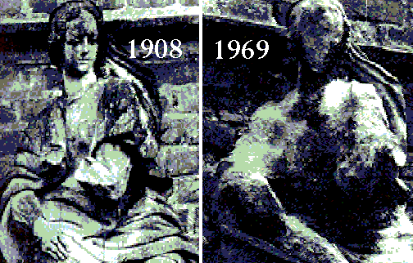
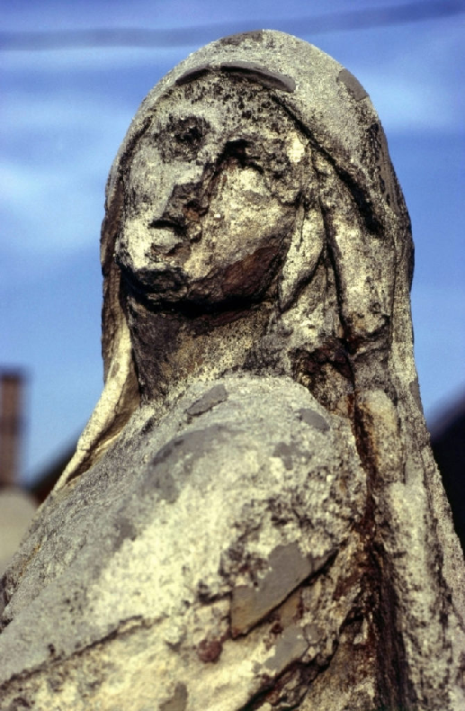
Acid rain - affect buildings and rocks

Slide 31
Acid rain - solutions
Industry such as power stations and factories can burn oil instead of coal to reduce sulfur dioxide emissions. Also, wind power and solar energy can be exploited and used more.
Factories can remove sulfur dioxide (desulfurization) from waste gases by scrubbing with fine spray of lime or limestone slurry (contain CaCO3). By this way 95% of SO2 in the flue gases can be removed. (scrubbers)
Reduces emissions of nitrogen oxides from motor vehicles by using catalytic converters which is fitted to the vehicle exhaust system.
International treaties and collaborative efforts is needed.
Notes:
Use wet scrubber.

Slide 32
Acid rain - individual effort
Acid rain may feel like a huge problem, but there are actually many things that you can do as an individual to help prevent it. Any step you can take to conserve energy will reduce the amounts of fossil fuels that are burned to produce that energy, thereby reducing the formation of acid rain.
How can you conserve energy?
Purchase energy-saving appliances;
carpool, use public transportation, walk, or bike whenever possible;
keep your thermostat low in the winter and high in the summer;
and turn off lights, computers, and appliances when you're not using them.

Slide 33
Acid rain - Task
Construct a flow chart to summarize causes, effects and solutions of acid rain.

Slide 34
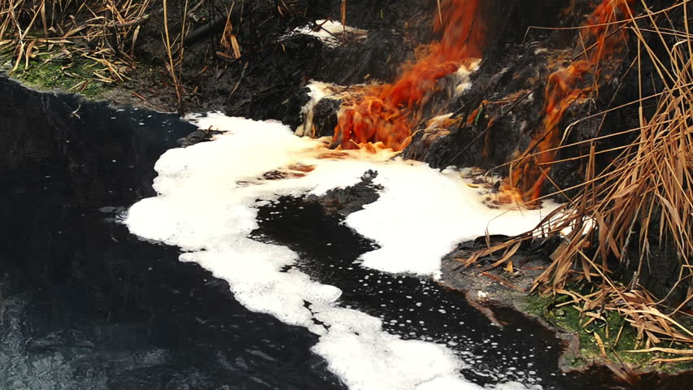
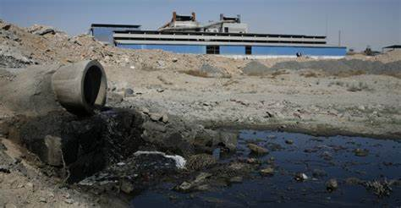
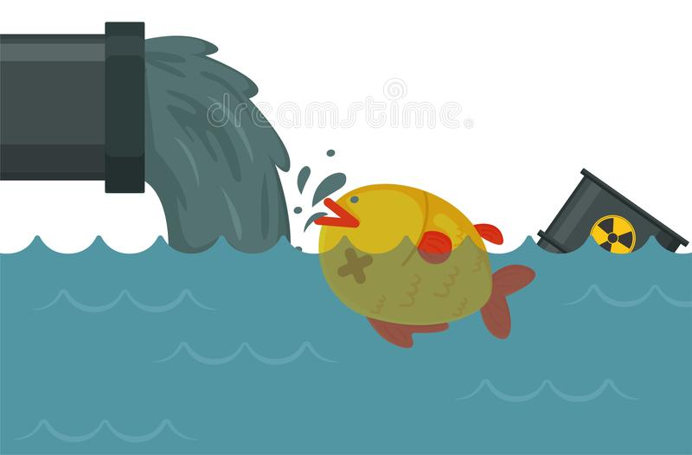
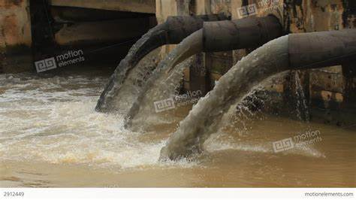
Water pollution - Chemical waste
https://www.britannica.com/science/toxic-waste

Slide 35
Water pollution - Chemical waste from industry
The term ‘heavy metal’ has particular application to cadmium, mercury, lead and arsenic, all of which appear in the World Health Organization's list of 10 chemicals of major public concern.
They can bind to and interfere with the functioning of vital cellular components such as enzymes if enter into organisms, hence cause severe damage even kill organisms.
Some elements otherwise regarded as toxic heavy metals are essential, in small quantities, for human health. These elements include vanadium, manganese, iron, cobalt, copper, zinc, selenium, strontium and molybdenum.
Potential sources of heavy metal poisoning include mining, industrial waste, paints, etc.
Mercury is a neurotoxin. Many products contain mercury, such as batteries, mercury thermometer, fluorescent light bulbs.
What to Do if a Mercury Thermometer Breaks https://www.epa.gov/mercury/what-do-if-mercury-thermometer-breaks
Notes:
Toxic waste products are divided into three general categories: chemical wastes, radioactive wastes, and medical wastes.

Slide 36
Water pollution - Chemical waste
For example, lead was a known toxin in the 19th century. Nevertheless, auto companies, oil companies, and the U.S. government authorized the manufacture, distribution, and use of tetraethyl lead, Pb(C2H5)4, in gasoline in the 1920s.
The lead industry pointed to lead’s importance to the automotive and petrochemical industries in increasing engine performance and reducing engine knock (spontaneous ignition of the fuel-air mixture in vehicle engines).
Similarly, despite evidence of lead paint’s toxic effects on children as early as the 1920s, the lead industry campaigned for decades to deter concerns. The National Lead Company, manufacturer of Dutch Boy paints and lead pigments, produced children’s colouring books, including The Dutch Boy’s Lead Party, extolling the benefits of lead paint.
The federal government finally banned lead in paint and gasoline in the 1970s and ’80s.

Slide 37
Water pollution - Chemical waste examples
Hooker Chemical and Plastics Corporation used an empty canal in Love Canal, a section of Niagara Falls, New York, in the 1940s and ’50s to dump 20,000 tons of toxic waste in metal drums.
After the canal was filled and the land given to the city, houses and an elementary school were built on the site.
By the late 1970s the toxic chemicals had leaked through their drums and risen to the surface, resulting in high rates of birth defects, miscarriages, cancer and other illnesses, and chromosome damage.
The neighbourhood was subsequently evacuated by September 1979.

Slide 38
Water pollution - Chemical waste examples
Although limited cases of accidental poisonings, such as from the accidental ingestion of lead and household cleaners, occur daily throughout the world, one of the first high-profile episodes of mass poisonings affecting neighbourhoods and whole cities occurred in Minamata, Japan, in the 1950s.
Many of the town’s residents contracted mercury poisoning resulting from the Nippon Chisso Hiryo Co.’s manufacturing of acetaldehyde, and that material was later associated with the deaths of at least 3,000 people.
Mercury from the production process spilled into the bay and entered the food chain, including seafood, which was the town’s primary protein source. Deformed fish appeared in Minamata Bay, and townspeople exhibited strange behaviours, including trembling, stumbling, uncontrollable shouting, paralysis, hearing and vision problems, and body contortions.
While mercury was long known to be a toxin (the neurological degeneration caused by mercury used in hat making in the 19th century led to the phrase “mad as a hatter”), Minamata vividly highlighted its dangers in the food chain.

Slide 39
Water pollution - Chemical waste examples
In addition, the danger of a sudden release of toxic material also looms in the aftermath of extreme weather events, natural disasters, and accidents.
Three Superfund toxic waste sites in and around New Orleans were flooded in 2005 by Hurricane Katrina, and toxic waste was found in debris deposited throughout the flooded area.
The devastating Indian Ocean earthquake and tsunami of 2004 stirred up and dispersed vast amounts of toxic wastes—including radioactive waste, lead, heavy metals, and hospital wastes—across the Indian Ocean basin.
And the tsunami that struck Japan in 2011, which caused the Fukushima nuclear accident, released tremendous amounts of irradiated water into the Pacific Ocean.
Those and other high-profile examples—including the Exxon Valdez oil spill in 1989, the Chernobyl disaster in 1986, the Bhopal gas leak in 1985, and the Three-Mile Island scare in 1979—raised public awareness and concern.

Slide 40
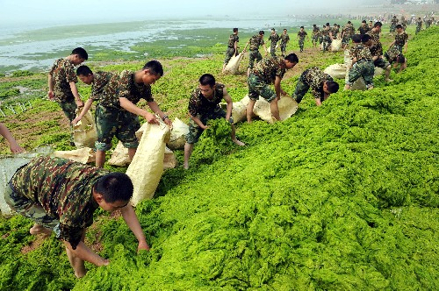

Water pollution - Eutrophication

Slide 41
Water pollution - Eutrophication: causes
Eutrophication is the enrichment of water with nitrogen, phosphorus, and other nutrients, causing algae to grow out of control or "bloom." Usually, the bloom itself is non-toxic, but an exception is a red tide, which produces natural toxins that can kill wildlife and harm humans.
Water pollution is the primary human source of the nutrients that cause eutrophication and dead zones (a region of reduced oxygen levels (hypoxia) in water).
Fertilizer, manure, industrial waste, and inadequately treated wastewater overload aquatic ecosystems. In addition, air pollution contributes to eutrophication. Nitrogen compounds from automobiles and factories are returned to water bodies through precipitation.
https://www.thoughtco.com/dead-zones-4164335
Notes:
A dead zone is a common name for a region of reduced oxygen levels (hypoxia) in water. The underlying cause of any dead zone is usually eutrophication.

Slide 42
Water pollution - Eutrophication: progress
1 Fertilizer, manure, industrial waste, and inadequately treated wastewater overload aquatic ecosystems. Waters are now enriched with nutrients.
2 Algae bloom.
Algae causes stratification. Sunlight reaches the algal layer, but it can't penetrate the growth, so photosynthetic organisms below the algae die.
3 When algae die, microorganisms decompose it.
4 The bacteria consume oxygen, quickly making water hypoxic. This occurs so rapidly sometimes even fish can't swim outside of a zone fast enough to escape death.
5 aquatic organisms such as fish and invertebrates die.

Slide 43
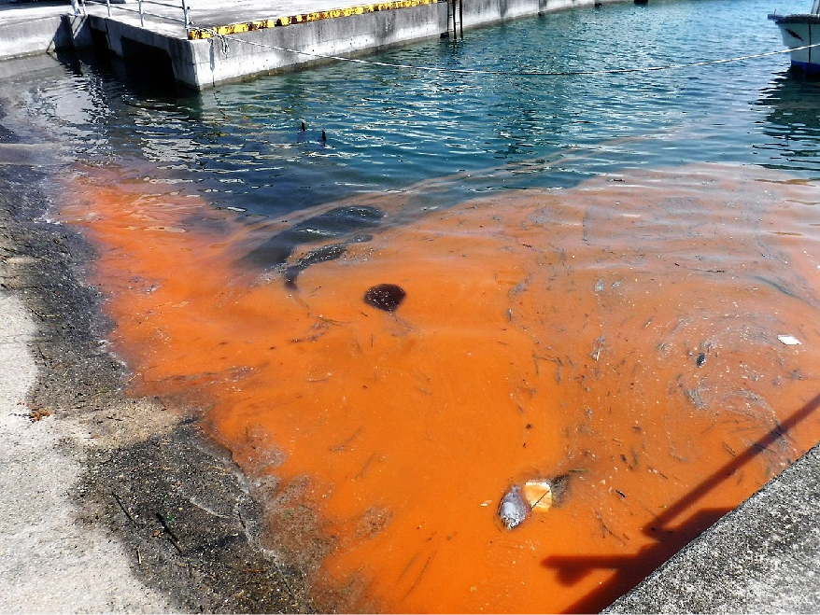
Water pollution - Eutrophication: red tide
Not all algal blooms are harmful.
Harmful algal blooms, or HABs, occur when colonies of algae—simple plants or protists that live in the sea and freshwater—grow out of control while producing toxic or harmful effects on people, fish, shellfish, marine mammals, and birds. The toxins may also make the surrounding air difficult to breathe. As the name suggests, the bloom of algae often turns the water red.
While many people call these blooms 'red tides,' scientists prefer the term harmful algal bloom.
Red tide

Slide 44
Water pollution - Eutrophication: remediation
The key to remediation is water and air pollution reduction. Some dead zones have been remediated, although the species that went extinct cannot be recovered.
For example, a large dead zone in the Black Sea all but vanished in the 1990s when farmers couldn't afford chemical fertilizers.
Since then, policymakers and scientists have sought to reverse other dead zones. The reduction of industrial effluents and sewage along the Rhine River has reduced nitrogen levels by 35 percent in the dead zone in the North Sea. Clean-up along the San Francisco Bay and Hudson River have reduced dead zones in the United States.
Yet, cleanup isn't easy. Both mankind and nature can cause problems. Hurricanes, oil spills, increased industry, and nutrient-loading from increased corn production to make ethanol have all worsened the dead zone in the Gulf of Mexico. Fixing that dead zone will require dramatic changes by farmers, industries, and cities all along the coast, the Mississippi River, its delta, and its tributaries.

Slide 45
Water pollution - Eutrophication: remediation
Today's environmental problems are so big they can seem overwhelming, but there are steps each individual can take to help reverse dead zones.
Minimize water usage.
Avoid using fertilizers. At least you can rotate garden crops to naturally replenish the soil.
Be mindful of air pollution. Drive less and reduce power consumption in the home.

Slide 46
Plastics

Slide 47
Videos
1. Plastics 101 - National Geographic.mp4
plastic production process, bioplastics
2. What really happens to the plastic you throw away - Emma Bryce.mp4
plastic travelling journey

Slide 48
Plastics
According to the trade association PlasticsEurope,
world plastic production grew from some 1.5 million tonnes (about 1.7 million tons) per year in 1950 to an estimated 275 million tonnes (303.1 million tons) by 2010 and 359 million tonnes (nearly 396 million tons) by 2018;
between 4.8 million and 12.7 million tonnes (5.3 million and 14 million tons) are discarded into the oceans annually by countries with ocean coastlines.
Sunlight and seawater embrittle plastic, and eventually break down larger objects into “microplastics”.
Recycling rates vary dramatically from country to country, with only northern European countries obtaining rates greater than 50 percent.

Slide 49
What’s bad about plastics?
1. persistent, not biodegradable.
They may take hundreds of years or more to break down into ever smaller particles (microplastics) that continue to pollute the soil and water.
2. clog drainage infrastructure
3. Animals mistake them for food. Birds and fish die after swallowing or choking on discarded plastic bags. Plastics accumulate, fill their stomachs, causing them to starve.
4. Cause entanglement, where it trap wildlife
5. Cause aesthetic blight, spoil the landscape.
6. Release toxic compounds used in its manufacture, such as phthalates, bisphenol A (BPA), and polybrominated diphenyl ether (PBDE).
All these compounds have been detected in humans and are known to disrupt the endocrine system.
Notes:
Organic materials “biodegrade” when they are broken down by other living organisms (such as fungi, bacteria, or other microbes) into their constituent parts, which are in turn recycled by nature as the building blocks for new life. The process can occur aerobically (with the aid of oxygen) or anaerobically (without oxygen). Substances break down much faster under aerobic conditions, as oxygen helps break the molecules apart, a process called oxidation.
Most landfills are fundamentally anaerobic because they are compacted so tightly, and thus do not let much air in. As such, any biodegradation that does take place does so very slowly.

Slide 50
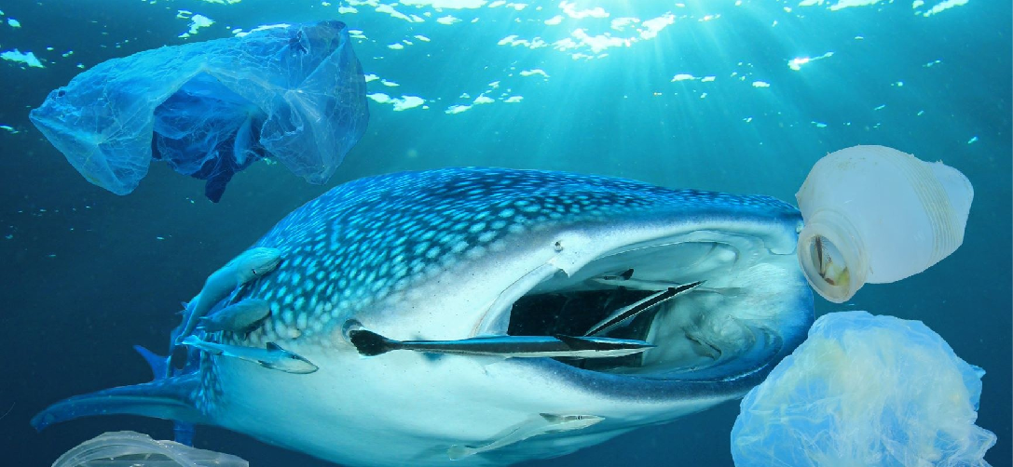
Plastic kills!

Slide 51
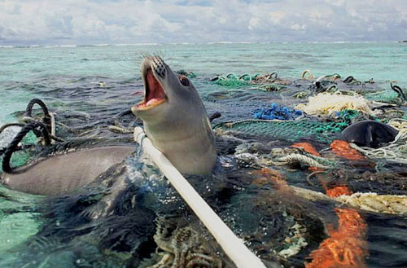
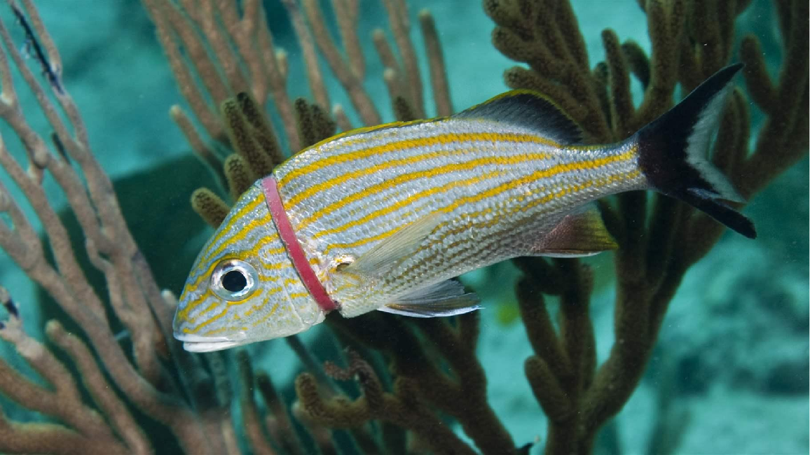
Plastic kills!

Slide 52
Plastic kills!

Slide 53
Non-biodegradable waste
Those industrial wastes which cannot be decomposed into non-poisonous substances are the non-biodegradable wastes.
Examples are plastics, fly ash, synthetic fibers, gypsum, silver foil, glass objects, radioactive wastes, etc. They are generated by iron and steel plants, fertilizer industries, chemical, drugs, and dyes industries.
It is estimated that about 10 to 15 percentage of the total industrial wastes are non-biodegradable and hazardous, and the rate of increase in this category of waste is only increasing every year.
They accumulate in the environment and enter the bodies of animals and plants causing diseases.
However, with the advancement in technology, several disposals, and reuse methods have been developed. Wastes from one industry are being treated and utilized in another industry. For example, the cement industry uses the slag and fly ash generated as waste by steel industries.

Slide 54
Radioactive waste - Nuclear fall-out
Radiation is energy. Radiation travels from its source in the form of energy waves or energized particles.
Unstable forms of elements emit ionizing radiation and are radioactive. There are some elements with no stable form that are always radioactive, such as uranium. Unstable elements that emit ionizing radiation are called radionuclides.
Radioactive decay is the emission of energy in the form of ionizing radiation which includes alpha particles, beta particles and/or gamma rays.
Exposure to ionizing radiation can cause radiation sickness and burns, also increase mutation rates in DNA of our cells which may lead to cancer.
Notes:
ionizing radiation, Radiation with so much energy it can knock electrons out of atoms. Ionizing radiation can affect the atoms in living things, so it poses a health risk by damaging tissue and DNA in genes.
beta particle, A form of particulate ionizing radiation made up of small, fast-moving particles. Some beta particles are capable of penetrating the skin and causing damage such as skin burns. Beta-emitters are most hazardous when they are inhaled or swallowed.
gamma rays, A form of ionizing radiation that is made up of weightless packets of energy called photons. Gamma rays can pass completely through the human body; as they pass through, they can cause damage to tissue and DNA.
Elements in the periodic table can take on several forms. Some of these forms are stable; other forms are unstable. Typically, the most stable form of an element is the most common in nature. However, all elements have an unstable form. Unstable forms emit ionizing radiation and are radioactive. There are some elements with no stable form that are always radioactive, such as uranium. Elements that emit ionizing radiation are called radionuclides.

Slide 55
Radioactive waste - Nuclear fall-out
Fallout, is the residual radioactive material (commonly refers to the radioactive dust and ash created) propelled into the upper atmosphere following a nuclear blast.
Globally, there have been at least 99 (civilian and military) recorded nuclear power plant accidents from 1952 to 2009. The two worst nuclear accidents are listed below.
1. Chernobyl (Ukraine) disaster in 1986 (a nuclear power plant) is the worst nuclear disaster in history.
2. 2011 Japanese Fukushima nuclear disaster. A magnitude 9.0 earthquake and associated tsunami triggered cooling problems. Radioactive steam was released into the atmosphere, and highly radioactive water spilled into the ocean through utility trenches.
Notes:
Late or delayed effects of radiation occur following a wide range of doses and dose rates. Delayed effects may appear months to years after irradiation and include a wide variety of effects involving almost all tissues or organs. Some of the possible delayed consequences of radiation injury, with the rates above the background prevalence, depending on the absorbed dose, include carcinogenesis, cataract formation, chronic radiodermatitis, decreased fertility, and genetic mutations.

Slide 57
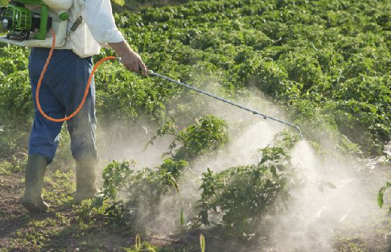
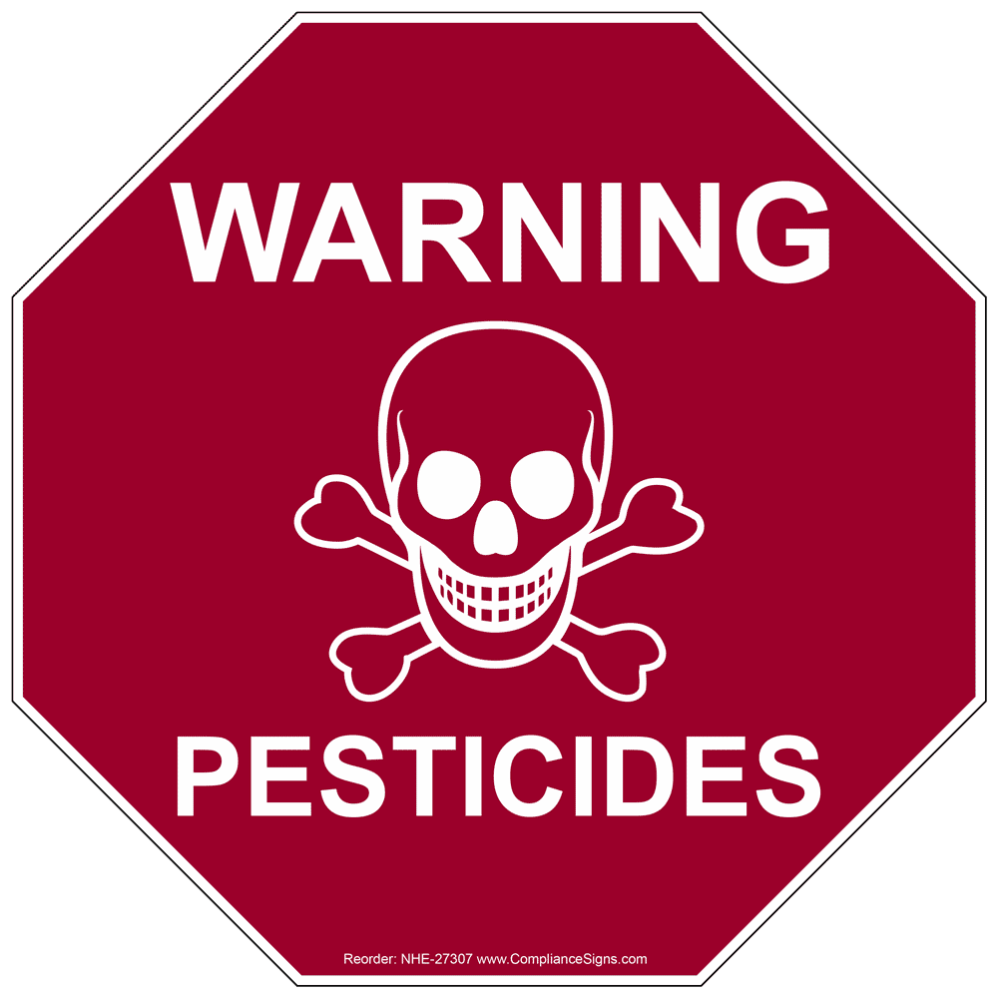
Pesticides - Problems
Might be persistent, taking years or more to be broken down. So it remains in pest’s bodies, soil, water, accumulates and enter food webs.
Many pesticides are not specific, harming other living organisms such as birds.
Decreases the general biodiversity in the soil.
Potential acute and chronic human health hazards, from short-term impacts such as headaches and nausea to chronic impacts like cancer, reproductive harm.
Notes:
By their nature, pesticides are potentially toxic to other organisms, including humans, and need to be used safely and disposed of properly.

Slide 58
Pesticides - DDT
DDT (dichloro-diphenyl-trichloroethane) was developed as the first of the modern synthetic insecticides in the 1940s.
It was initially used with great effect to combat malaria, typhus, and the other insect-borne human diseases among both military and civilian populations.
It also was effective for insect control in crop and livestock production, institutions, homes, and gardens. DDT's quick success as a pesticide and broad use in the United States and other countries led to the development of resistance by many insect pest species.
Notes:
The publication in 1962 of Rachel Carson's Silent Spring stimulated widespread public concern over the dangers of improper pesticide use and the need for better pesticide controls.

Slide 59
Pesticides - DDT
In 1972, EPA (Environmental Protection Agency in United States) issued a cancellation order for DDT based on its adverse environmental effects, such as those to wildlife, as well as its potential human health risks.
Since then, studies have continued, and a relationship between DDT exposure and reproductive effects in humans is suspected, based on studies in animals.
In addition, some animals exposed to DDT in studies developed liver tumors. As a result, today, DDT is classified as a probable human carcinogen by U.S. and international authorities.

Slide 60
Pesticides - DDT
DDT is:
known to be very persistent in the environment,
will accumulate in fatty tissues, and
can travel long distances in the upper atmosphere.
After the use of DDT was discontinued in the United States, its concentration in the environment and animals has decreased, but because of its persistence, residues of concern from historical use still remain.
In September 2006, the World Health Organization (WHO) declared its support for the indoor use of DDT in African countries where malaria remains a major health problem, citing that benefits of the pesticide outweigh the health and environmental risks.
DDT is one of 12 pesticides recommended by the WHO for indoor residual spray programs. It is up to individual countries to decide whether or not to use DDT.

Slide 61
Toxic waste - DDT
Toxic waste has been implicated in deaths and health problems such as cancers, birth defects, miscarriages, low birth weight, neurological disorders, liver disease, developmental disorders, hypertension, and heart defects.
In ecosystems, toxic wastes have caused substantial damage to animal and plant populations. Such wastes overwhelm natural restorative processes, destroy habitats, and reduce populations of sensitive species outright or inhibit their reproductive success.
The decline of the bald eagle population by the 1960s and the double-crested cormorant population by the early 1970s as a result of DDT use are vivid examples. Similarly, PCBs and other toxins are blamed for many whale deaths, bird deformities, and endocrine, reproductive, neurological, and immune system disruptions in humans and wildlife.
Notes:
polychlorinated biphenyls (PCBs)

Slide 62
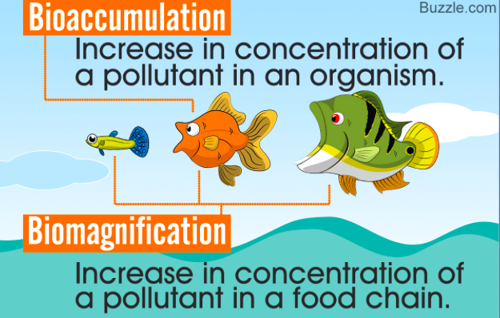
Bioaccumulation
Bioaccumulation is the gradual accumulation of substances, such as pesticides or other chemicals, in an organism.
Bioaccumulation occurs when an organism absorbs a substance at a rate faster than that at which the substance is lost by catabolism and excretion.

Slide 63
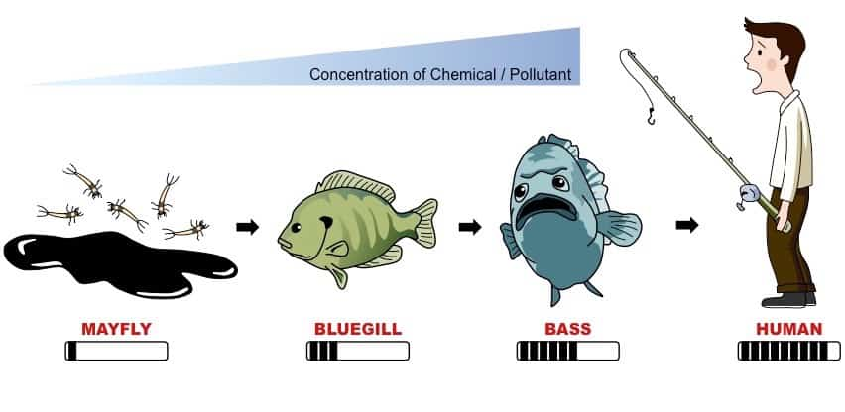
Bioaccumulation

Slide 64
Bioaccumulation - PBTs
The world’s most dangerous chemical toxins, are categorized as persistent organic pollutants (POPs).
Several POPs are pesticides: aldrin, chlordane, DDT, dieldrin, endrin, heptachlor, hexachlorobenzene, mirex, and toxaphene. Other POPs are produced during the combustion process. For example, dioxins, furans and polychlorinated biphenyls (PCBs).
Other toxins such as arsenic, beryllium, cadmium, copper, lead, nickel, and zinc belong to a wider group of chemicals called persistent bioaccumulative toxins (PBTs), which include the POPs and can linger in the environment for long periods.
Notes:
Biomagnification is a process in which animals higher in the food chain - humans - accumulate these these harmful toxins in significantly high concentrations. Simply put, predators higher on the food chain are much more likely to have genetic mutations, diseases, birth defects, and several other deleterious effects of improper certified product destruction.

Slide 65
Bioaccumulation - PBTs
Peristent, bioaccumulative and toxic (PBT) substances are chemical compounds that are resistant to degradation (breaking down), are highly mobile in the environment and exhibit a high degree of toxicity.
PBTs bioaccumulate (meaning the substance is retained and builds up within a single organism) and biomagnify up the food chain (meaning that organisms at higher levels on the food chain show increasing levels of the substance because they are constantly eating the substance embedded in the tissue of their prey).

Slide 66

Water pollution - Female contraceptive hormones
After the active ingredient in most birth control pills has done its duty preventing pregnancy, it begins a second life as a pollutant that can harm wildlife in waterways.
It has feminizing effect on male fish such as producing fewer sperm, creating intersex fish and can alter female-to-male ratios. Hence it raises concerns about female hormones leaching into water supply and affect humans.
Notes:
Fish struggle to fertilize eggs three generations after exposure to contraceptive hormone, raising questions about the effects on humans.
Intersex conditions occur when exposure to chemicals disrupts the hormonal systems of an animal, leading to the presence of both male and female characteristics in an animal that should exhibit the characteristics of just one sex in its lifetime.

Slide 67
Waste disposal
What happen to the solid trash we throw away?
Incineration - burn to ashes
Landfill - need management
Recycle
Sanitary landfill:
Liners: prevent leachate from leaking into the soil.
Monitoring wells: tested nearby wells regularly to ensure that pollutants are not leaching into the water.
Compacted layers
Vent pipes: allow the gases produced as waste decomposes - namely methane and carbon dioxide - to vent into the atmosphere and prevent fires and explosions.
Notes:
Trash, packaging, and waste improperly disposed on land is washing into rivers, streams, lakes and creeks, and from there to the ocean. This is estimated to account for 80% of the marine debris in the oceans. The remaining 20% is attributed to at-sea losses from ocean going vessels, from lost or abandoned fishing gear and from accidental or intentional dumping.
Plastic trash has the greatest potential to harm the water environment, wildlife and humans.. It is transported by rivers to the ocean, where it moves with the ocean currents, and persists in that environment for years, breaking down into smaller and smaller pieces.

